Slide 1
Capstone Project Estimate Product Power
UC Berkeley: Professional Certificate in Machine Learning and Artificial Intelligence
Michael King
September 2025

Slide 2
Executive Summary
Problem | A critical lack of centralized power information for products, leading to significant data gaps. The electricity consumed by Cisco’s products represents the company's largest source of greenhouse gas emissions, making accurate power estimation crucial for environmental initiatives.
Approach | Develop a multi-stage supervised learning model using Bill of Materials (BOM) and product classification data. Stage 1: Product Classification: Classify products into types (MECH, MOD, PWR). Stage 2: Weight Prediction: Predict product weight (kg). Stage 3: Power Prediction: Estimate product power (Watts). Data preprocessing involved consolidation, removal of missing data, and log transformation to handle skewed distributions.
Key Results | Product Classification (Model 1): Gradient Boosting achieved a strong 94% accuracy and F1-score, significantly outperforming the 45% dummy baseline. This ensures reliable identification of critical product types. Product Weight Prediction (Model 2): Random Forest delivered a Test RMSE of 1.93, a substantial improvement over the 4.78 dummy baseline, particularly for products under 20 kg. Product Power Prediction (Model 3): Random Forest achieved the lowest Test RMSE of 116.50, markedly better than the 241.43 dummy baseline. This model provides reliable power predictions essential for emissions calculations.
Impact | Establishes a robust, data-driven framework for estimating product power, addressing a significant data gap. Enables more accurate tracking and management of greenhouse gas emissions linked to product energy consumption. Provides a strong foundation for consistent and confident product classification and attribute prediction, supporting sustainability goals.

Slide 3
Project Overview

Slide 4
Problem Statement
Problem | Power information has not been collected and managed in a centralized manner, resulting in many products lacking this data.
Goal | The objective is to create a model that can estimate the typical power of our products.
Importance | The electricity consumed by Cisco’s products represents its largest source of greenhouse gas emissions. By improving estimates of power for products lacking data, we can more accurately calculate the total annual emissions resulting from the sale and use of our products. This enhanced estimation supports better tracking and reduction of our overall environmental impact.
Proposed Process | Product Classification: Develop supervised learning to predict product type based on Bill of Materials (BOM) information and other categorical data. Predict Product Weight: Develop a supervised learning model to predict product weight, leveraging the relationship between weight and BOM information. Predict Product Power: With the completed dataset to train a new supervised learning model that predict power for products without power data. This approach systematically addresses missing data by grouping products, estimating weight as a proxy for power, and then predicting power usage for all products.

Slide 5
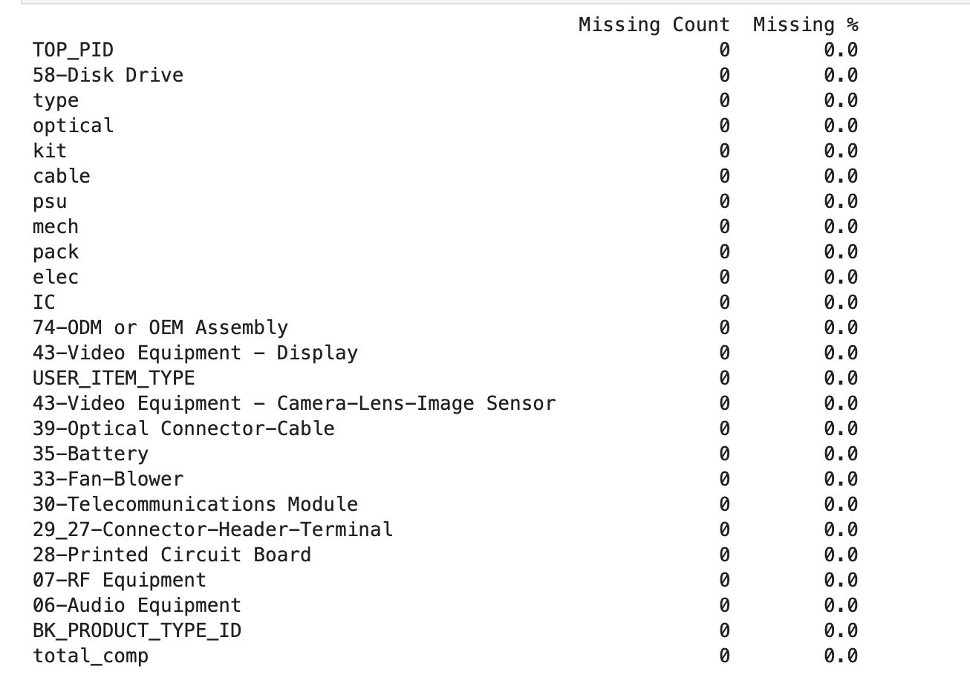
Data Acquisition
Data was exported from both the product lifecycle management tool and product creation tool.
The dataset includes bill of material information (such as component types) and product classification details.
During initial data exploration, the dataset contained 93,449 rows and 94 columns, with data types distributed as 84 int64 columns, 6 object columns, and 4 float64 columns.
Using subject matter expert (SME) knowledge, the columns were consolidated to 25, consisting of 21 int64 and 4 object columns.
Rows with missing data were removed, as there was no viable method to fill these gaps resulting in a final data frame with 41,279 rows.
An analysis was then performed on this refined dataset.
Figure: Code output showing no missing data.

Slide 6
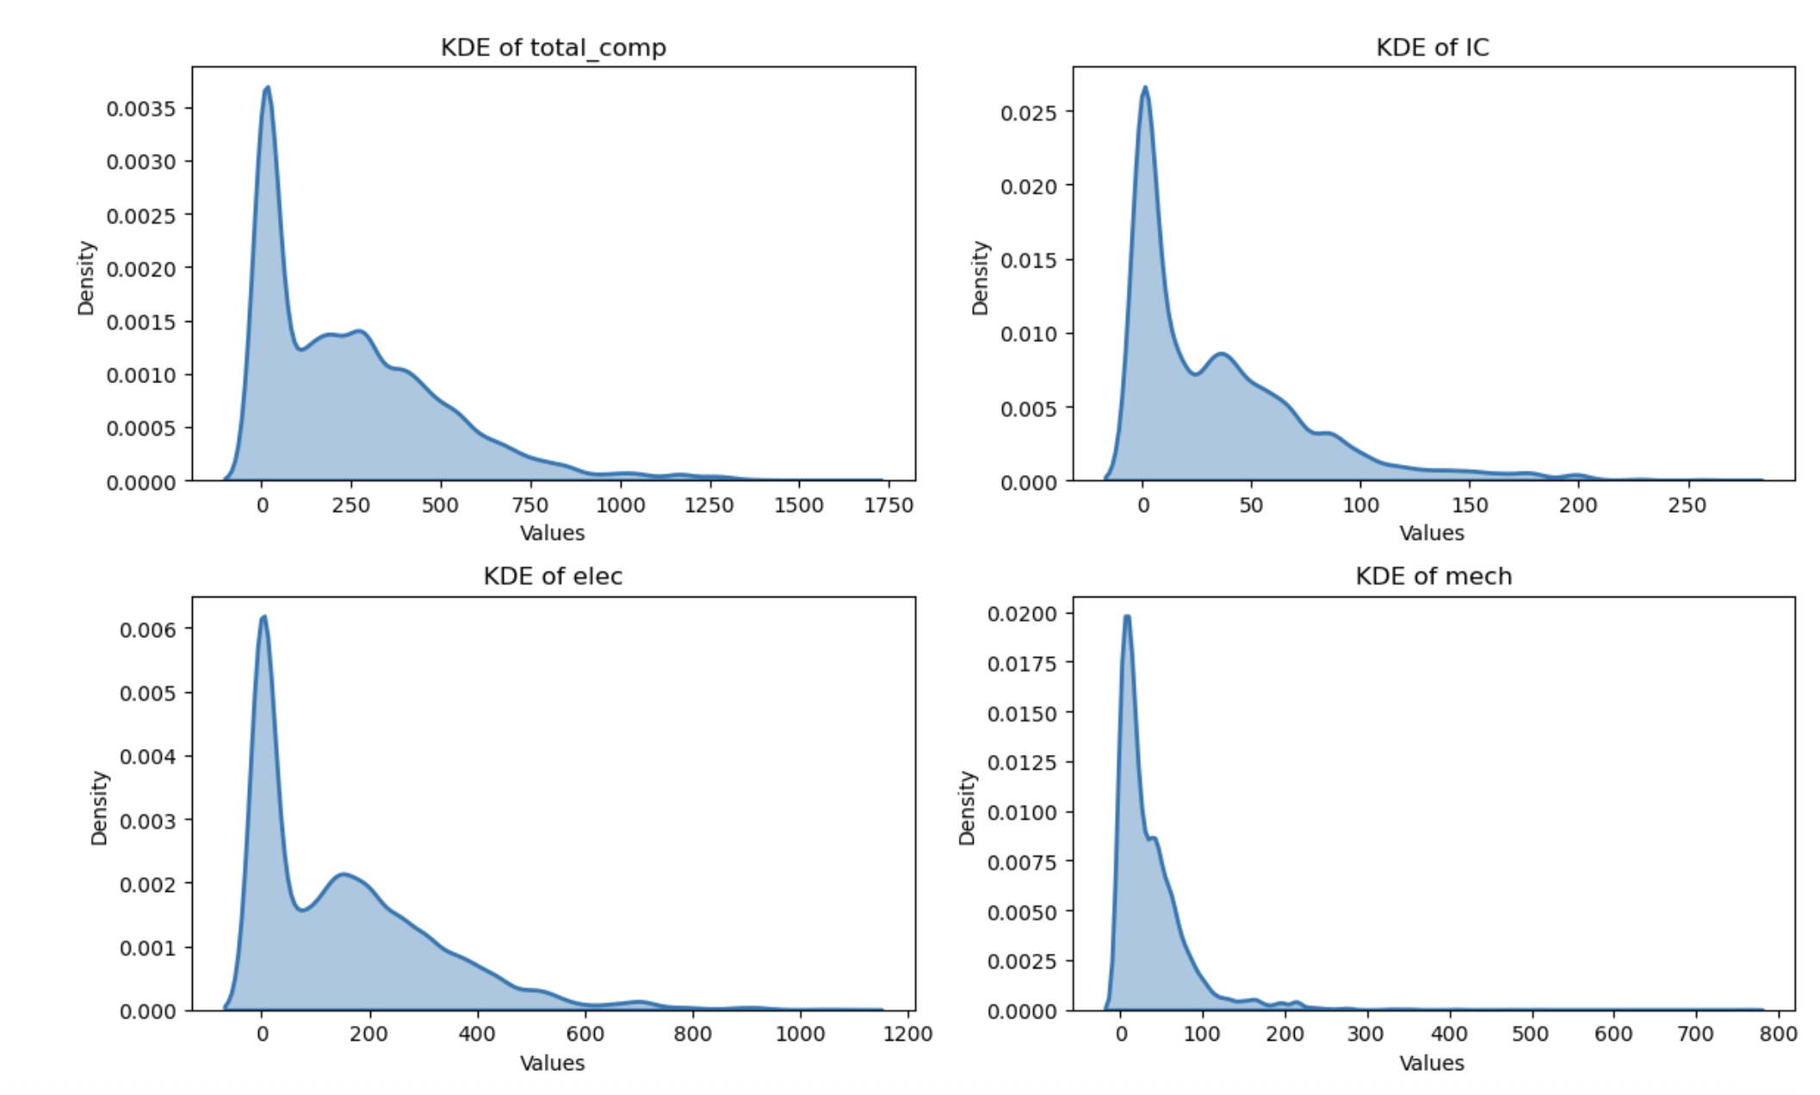
Analyzing the Skew: Component Value Distributions
4 key numerical features were chosen to analyze skew. The features were chosen based on SME knowledge.
All four features have distributions heavily skewed towards lower values.
Most observations fall into the lower numerical ranges, with progressively fewer observations as the values increase.
Some features also show secondary concentrations of values at slightly higher points.
Figure: Four KDE plots of 4 key features, total_comp, IC, elec and mech.

Slide 7
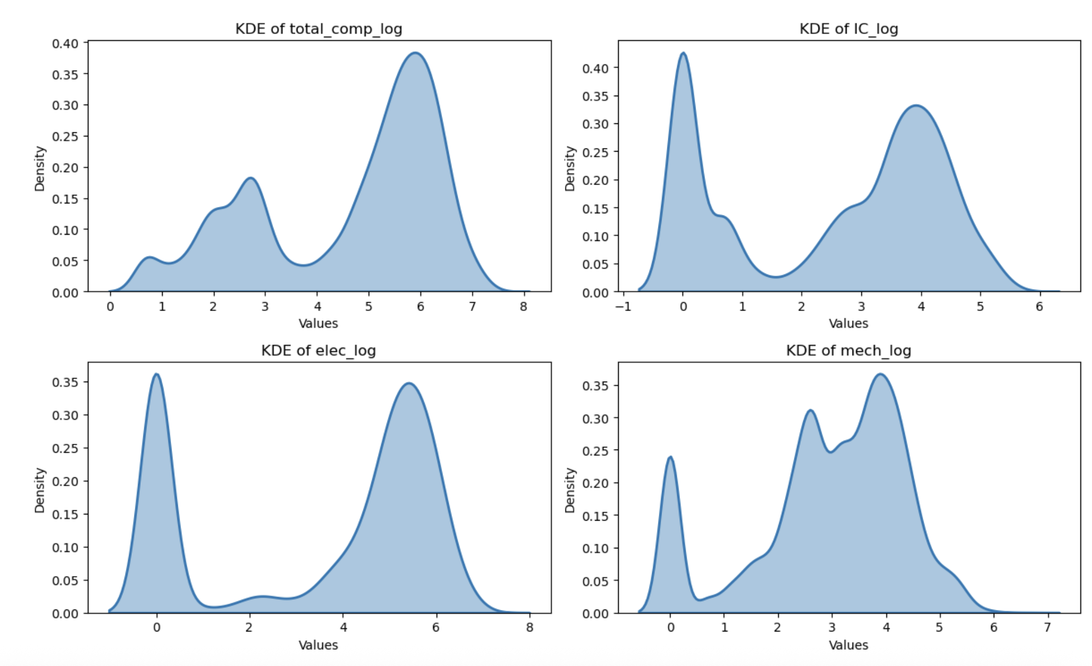
Visualizing Log-Transformed Data
By applying a log function, the data's skewness was corrected, yielding a more balanced and less skewed distribution.
This preprocessing step is expected to enhance the performance and stability of the predictive model.
In these specific plots, most distributions appear to be bimodal or multimodal, suggesting there might be distinct groups or clusters within the underlying data for each variable.
Figure: KDE plots after log transformation performed.

Slide 8
EDA – 5 Key Insights
High missingness removed → After dropping incomplete rows, final dataset shrank from 93,449 to 41,279 records (56% retained).
Skewed feature distributions → Core variables (e.g., total_comp, IC, elec, mech) were heavily concentrated at low values, reducing model balance.
Log transformation revealed subgroups → Post-transformation, distributions appeared bimodal/multimodal, suggesting distinct product families.
Outliers distorted predictions → Products >20 kg (≈2.3% of data) doubled weight RMSE, so excluded from initial modeling.
Target variable patterns →
Weight: Majority <20kg; heavy-tail required filtering.
Power: 80% of products <50W, but long-tail extended beyond 400W.
*Some insights were found on the data in preparation for other parts of the model.

Slide 9
Model 1: Product Classification

Slide 10
Product Classification Model Development
Goal | Develop a supervised learning model to predict product type based on Bill of Materials (BOM) information and other categorical data.
Target Variable (Product Type) | MOD (Modular): A modular component that is integrated into the final product. MECH (Mechanical): A mechanical component that operates without requiring power. PWR (Power): A powered component or product that consumes energy during use.
Process | Split the dataset into training and testing sets using train, test, split with 30% test size. Establish a baseline using a dummy classifier. Preprocess features with a column transformer: Apply Standard Scaler to numerical columns. Apply One Hot Encoder to categorical columns. Define candidate models and hyperparameters in a dictionary for use with Grid Search CV. Train and evaluate models, then select the top three performers. Build an ensemble (Voting Classifier) using the top models and compare its performance to individual models. Use the best-performing model to predict labels for the unlabeled dataset.

Slide 11
Product Classification Model Parameters
 | KNN | Logistic Regression | SVC | Decision Tree | Random Forest | Gradient Booster
Hyperparameter 1 | Neighbors | Regularization Strength | Regularization Strength | Max Depth | Estimators | Estimators
Parameter Set 1 | 3, 5, 7, 9, 11 | 0.01, 0.1, 1, 10, 100 | 0.1, 1, 10 | 5, 10, 15 | 100, 200 | 100, 200
Hyperparameter 2 | Weights | Penalty | Kernal | Min Sample Split | Max Depth | Learning Rate
Parameter Set 2 | uniform, distance | l1, l2 | linear, rbf | 2, 5, 10 | 5, 10, 20 | 0.01, 0.1
Hyperparameter 3 |  |  |  | Min Sample Leaf | Min Sample Split | Max Depth
Parameter Set 3 |  |  |  | 1, 2, 4 | 2, 5 | 3, 5
Hyperparameter 4 |  |  |  | Criterion | Min Sample Leaf
Parameter Set 4 |  |  |  | gini, entrophy | 1, 2

Slide 12
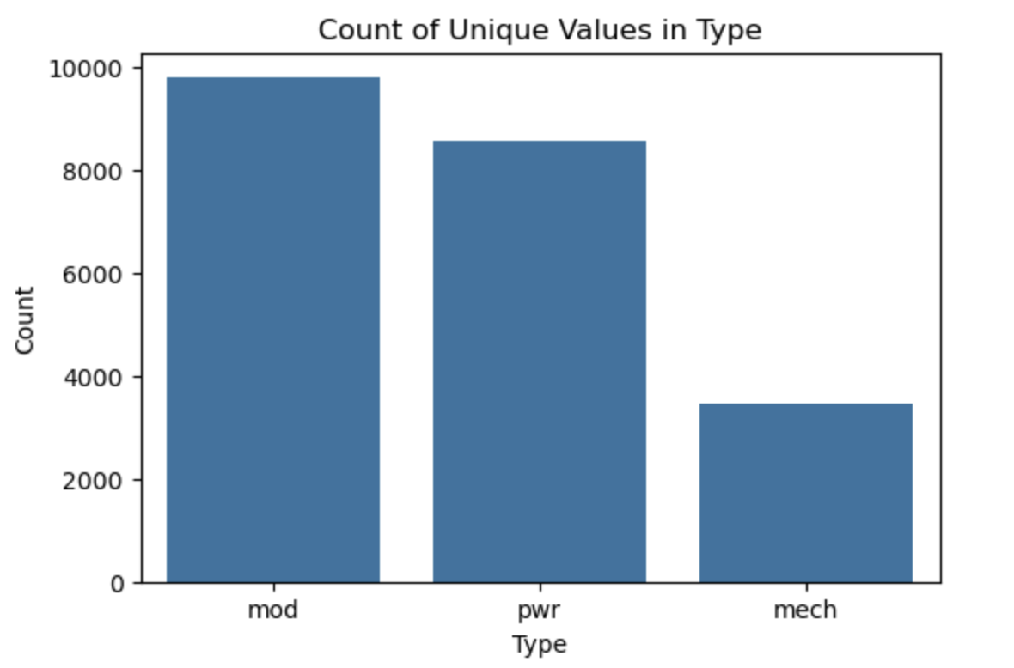
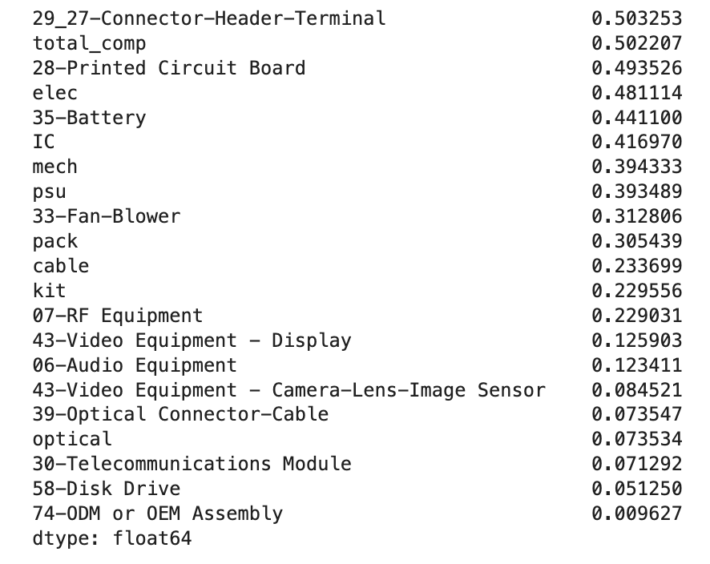
Product Classification Model Development
Correlation Data for Model 1: Product Classification
Figure: Initial count for labeled training data of MOD, PWR and MECH products.
Figure: Correlation of numerical data product type classification.

Slide 13
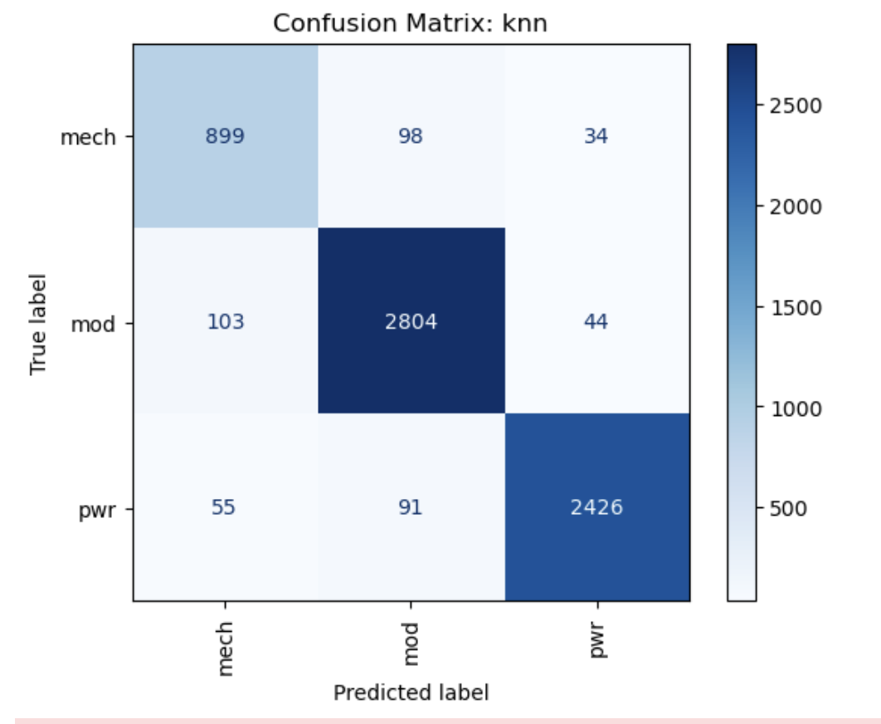
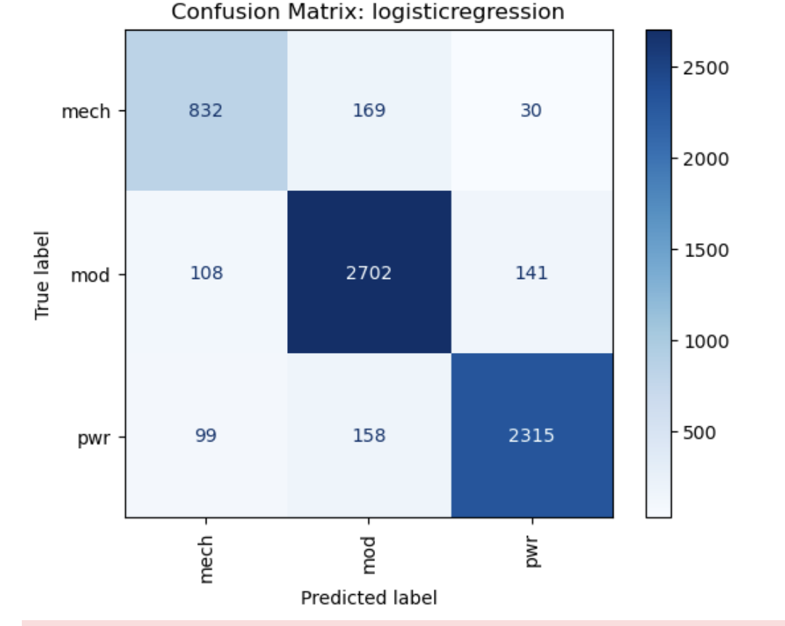
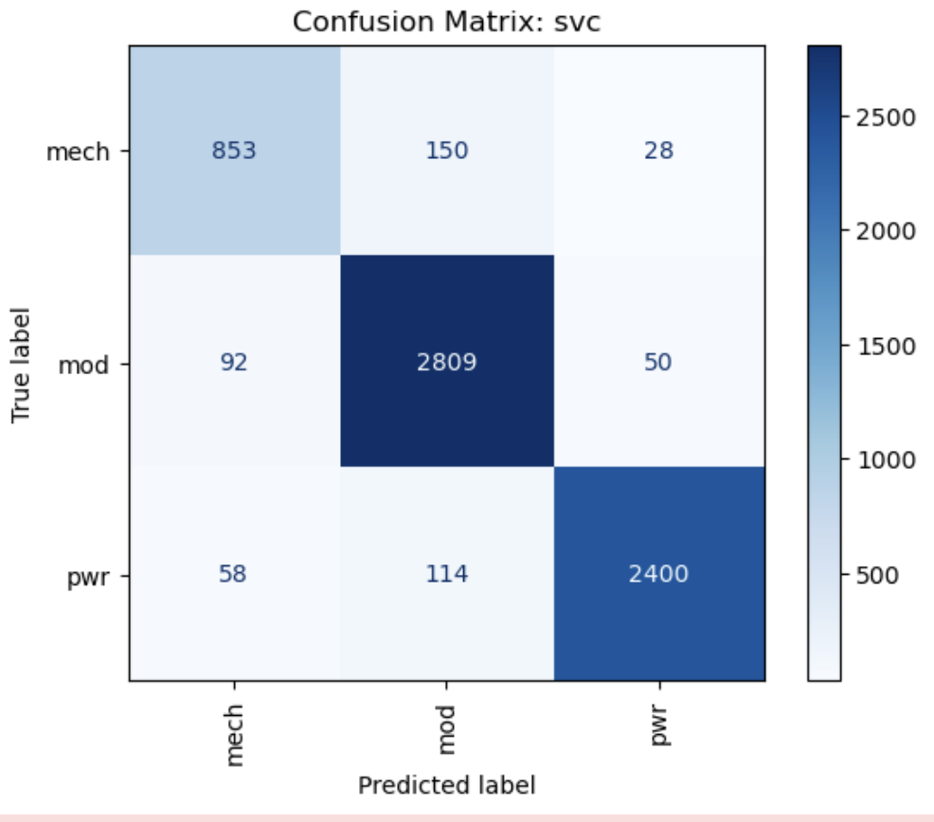
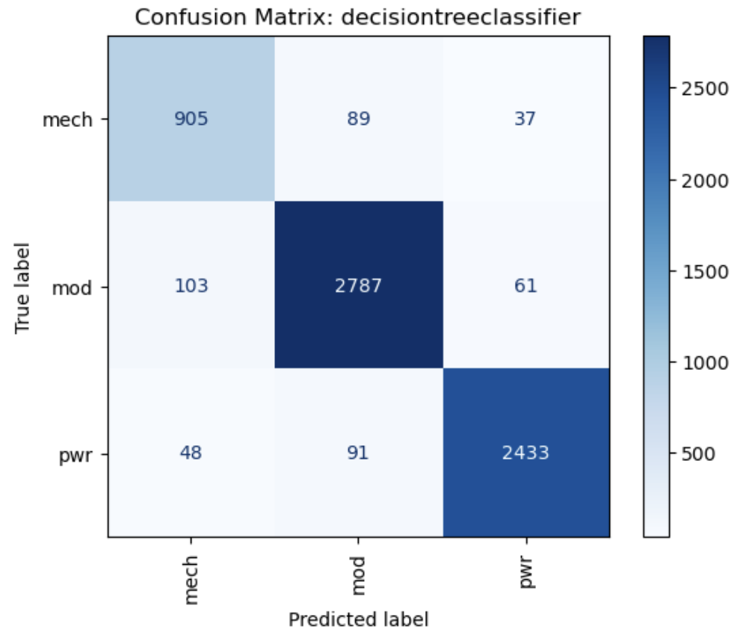
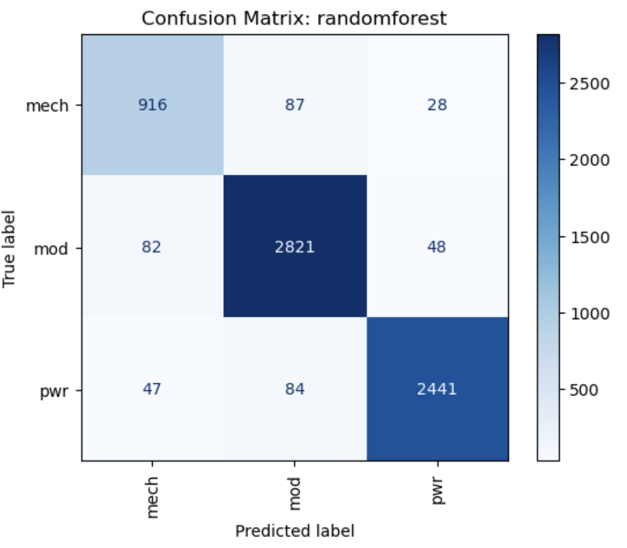
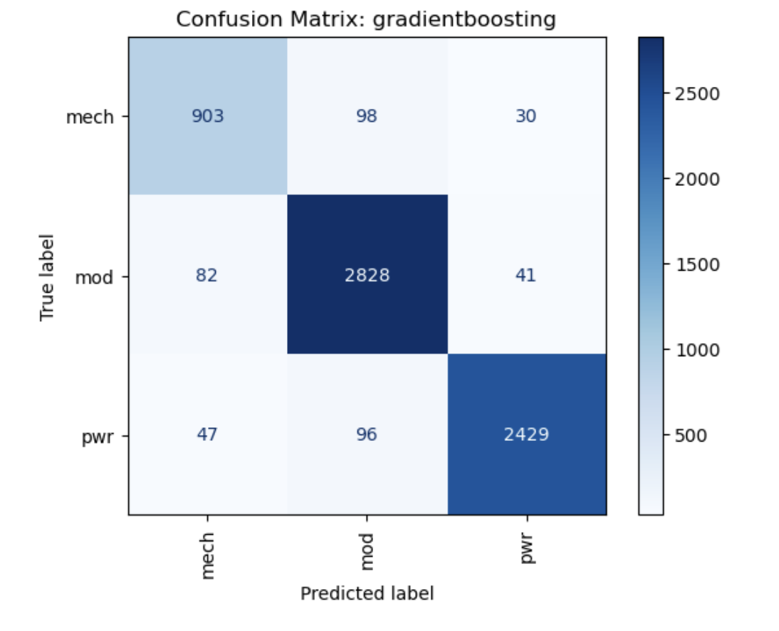
Model 1: Product Classification Confusion Matrix Results

Slide 14
Confusion Matrix Explanation
What a Confusion Matrix Shows:
Rows (True label): Represent the actual classes of the data points. In this case, the classes are MECH, MOD, and PWR.
Columns (Predicted label): Represent the classes predicted by the model.
Diagonal Elements: The numbers along the main diagonal (e.g., 899 for MECH in KNN) indicate the number of instances that were correctly classified for each class (True Positives).
Off-Diagonal Elements: The numbers outside the main diagonal indicate misclassifications. For example, in the KNN matrix, 98 instances that were actually MECH were predicted as MOD.
By examining these matrices, one can compare how well each model performs in classifying data into the MECH, MOD, and PWR categories, identifying which classes are often confused with others by each algorithm.

Slide 15
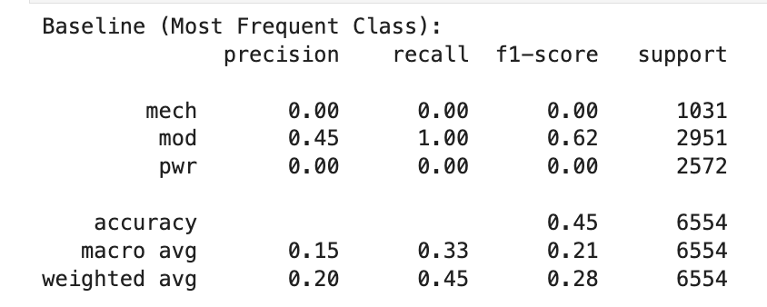
Model 1: Product Dummy Classification Results
Model 1 Dummy Classification Results
Mod is the majority class (2951/6554).
If Mod was chosen every time the accuracy would be 45%, therefore any model should perform better than the 45% accuracy and 62% F1-score.

Slide 16
Model 1: Classification Results
Top 3 Models | Train Score | Test Score | Average Fit Time (s) | Precision | Recall | F1
KNN | 0.979203 | 0.935154 | 0.233768 | 0.935829 | 0.935154 | 0.935382
Logistic Regression | 0.888758 | 0.892432 | 3.089665 | 0.893058 | 0.892432 | 0.892570
SVC | 0.934798 | 0.924931 | 2.086301 | 0.925440 | 0.924931 | 0.924859
Decision Tree | 0.961415 | 0.934544 | 0.026990 | 0.934995 | 0.934544 | 0.934723
Random Forest | 0.975476 | 0.942630 | 0.360543 | 0.942998 | 0.942630 | 0.942744
Gradient Boosting | 0.965339 | 0.939884 | 5.335005 | 0.940287 | 0.939884 | 0.939949
Top 3 Models | Train Score | Test Score | Average Fit Time (s) | Precision | Recall | F1
Random Forest | 0.975476 | 0.942630 | 0.360543 | 0.942998 | 0.942630 | 0.942744
Gradient Boosting | 0.965339 | 0.939884 | 5.335005 | 0.940287 | 0.939884 | 0.939949
KNN | 0.979203 | 0.935154 | 0.233768 | 0.935829 | 0.935154 | 0.935382
Ensemble Test Accuracy: 0.9399
Initial results show the top 3 models were KNN, Random Forest and Gradient Boosting.
Using those 3 models, the ensemble test accuracy was 0.9399.
The best model selected was gradient boosting with a test score of ~94%. The F1 score was also the highest at ~94%.

Slide 17
Model 1: Results Summary
Goal | Develop supervised learning to predict product type based on Bill of Materials (BOM) information and other categorical data.
Results | The best model selected was gradient boosting with a test score of ~94% which is supplier to the dummy classifier of 45%. The F1 score was also the highest at ~94%. The F1 score is a way to measure how well a model balances precision and recall. Precision asks: “When the model predicts something as positive, how often is it correct?” Recall asks: “Out of all the actual positives, how many did the model find?” The F1 score combines these two into a single number. A high F1 score means the model is good at both: avoiding too many false alarms (precision), and not missing too many real positives (recall). It’s important to minimize false negatives, since it’s better for more products to be classified as PWR than for true PWR products to be missed.
Best Parameters | Learning Rate: 0.1 Max Depth: 5 N Estimators: 200
Summary | We built a supervised learning model to classify products using Bill of Materials data, and Gradient Boosting emerged as the most effective approach. The model achieved about 94% accuracy, ensuring reliable identification of PWR products and reducing the risk of critical items being overlooked. This balance of accuracy and coverage provides a strong foundation for more consistent and confident product classification.

Slide 18
Model 2 – Weight Prediction

Slide 19
Product Weight Prediction Model Development
Goal | Develop a supervised learning model to predict product weight, leveraging the relationship between weight and BOM information.
Target Variable | Product weight in kilograms
Process | Split the dataset into training and testing sets using train, test, split with 25% test size. Establish a baseline using a dummy classifier. Preprocess features with a column transformer: Apply Standard Scaler to numerical columns. Preprocess features with transformed target regressor. Define candidate models and hyperparameters in a dictionary for use with Grid Search CV. Model is scored using negative root mean squared error. Use the best-performing model to predict labels for the unlabeled dataset.

Slide 20
Product Weight Prediction Model Parameters
 | Linear Regression | KNN | SVR | Random Forest | Gradient Booster
Hyperparameter 1 | Regularization Strength | N Neighbors | Regularization Strength | N Estimators | N Estimators
Parameter Set 1 | 0.01, 0.1, 1, 10, 100 | 3, 5, 7, 9, 11 | 0.1, 1, 10 | 100, 200 | 100, 200
Hyperparameter 2 | Penalty | Weights | Kernal | Max Depth | Learning Rate
Parameter Set 2 | l1, l2 | Uniform, Distance | linear, rbf | None, 5, 10 | 0.01, 0.1
Hyperparameter 3 |  |  | Epsilon | Min Sample Split | Max Depth
Parameter Set 3 |  |  | 0.01, 0.1, 1.0 | 2, 5 | 3, 5
Hyperparameter 4
Parameter Set 4

Slide 21
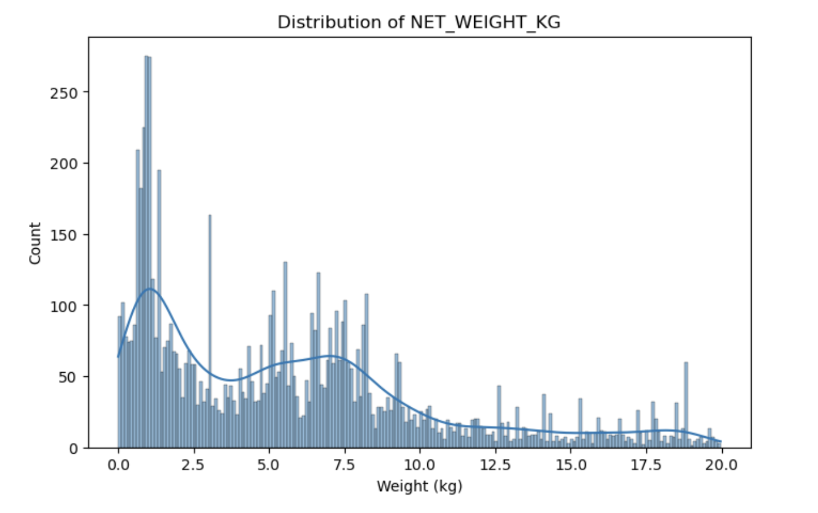
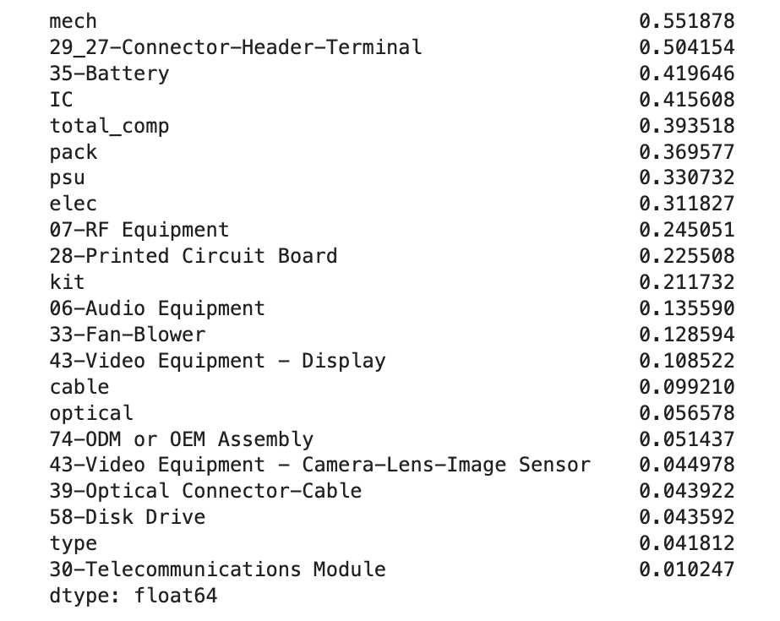
Product Weight Prediction Model Development
Correlation Data for Model 2: Weight Prediction
Figure: Distribution of net weight across products
Initial modeling could not produce a model that was more accurate than a dummy model.
It was determined that outliers where affecting the results and a solution could be found if only products weight < 20 kg’s was used
Figure: Correlation of numerical data against target variable (net weight)

Slide 22
Model 2: Prediction Results
Type | Test RMSE
Dummy Classifier | 4.78
Type | Test RMSE
Linear Regression | 4.1
KNN | 2.34
SVR | 3.01
Random Forest | 1.93
Gradient Boosting | 2.36
Hyperparameter | Value
N Estimators | 100
Max Depth | None
Min Sample Split | 5
The dummy classifier produced a test RMSE of 4.78.
Among the five models, Random Forest achieved the lowest RMSE of 1.93, using hyperparameters: n_estimators = 100, max_depth = None, and min_samples_split = 5.
RMSE was chosen as the scoring metric because:
It penalizes large prediction errors, helping models minimize outliers.
It provides a consistent basis for comparison across different models.

Slide 23
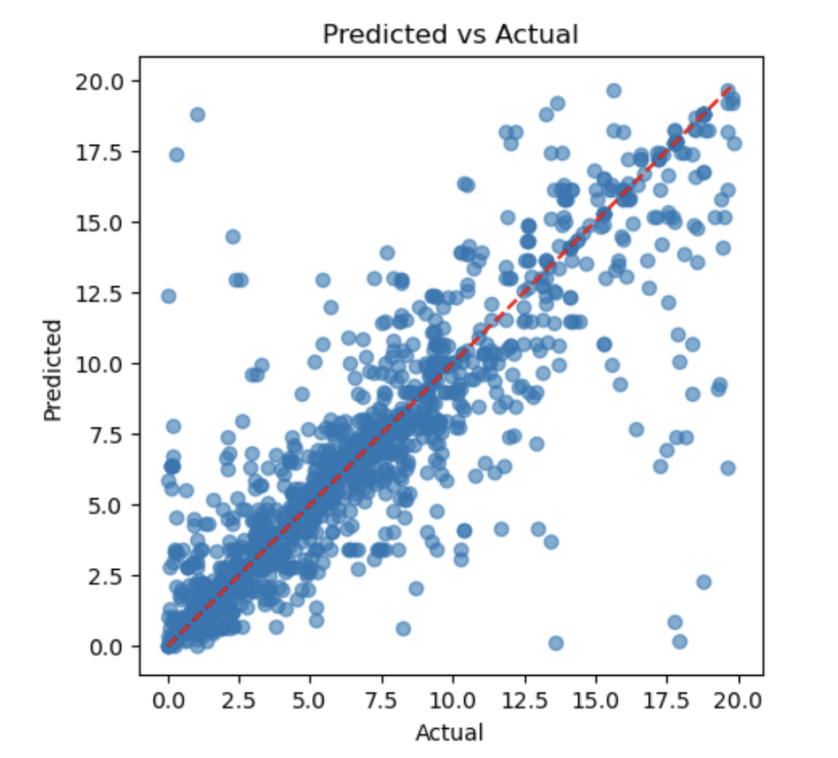
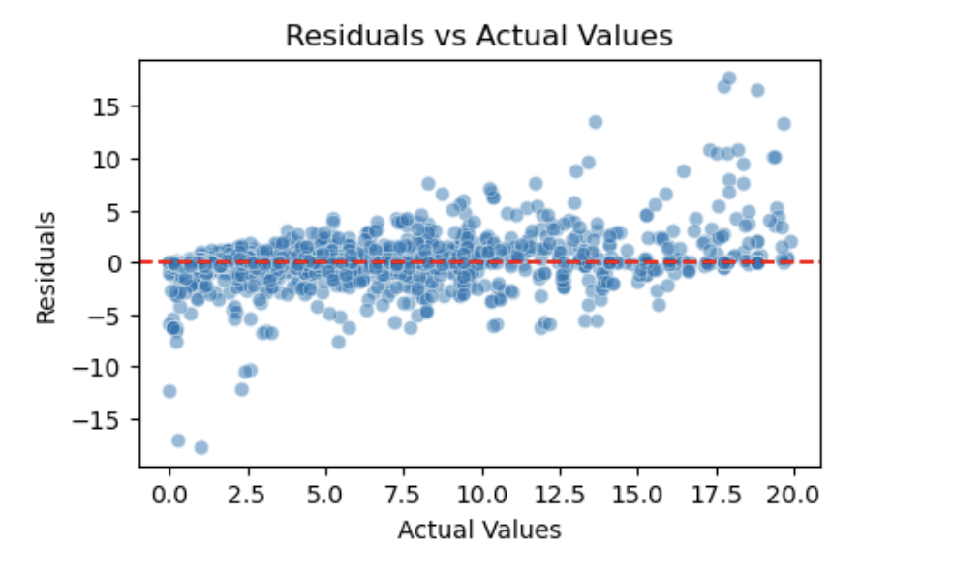
Model 2: Product Weight Prediction Results
A Predicted vs. Actual plot compares model predictions to true values, with points near the diagonal line y=x indicating low prediction error.
Points above or below the diagonal show over- or under-predictions and scattered or patterned deviations reveal model errors or bias.
A Residuals vs. Actuals plot shows the differences between predicted and actual values (residuals) on the y-axis against actual values on the x-axis.
Points scattered randomly around zero indicate a good fit, while patterns or trends suggest bias or model misspecification.

Slide 24
Model 2: Results Summary
Goal | Develop a supervised learning model to predict product weight, leveraging the relationship between weight and BOM information.
Results | The dummy classifier produced a test RMSE of 4.78. Among the five models, Random Forest achieved the lowest RMSE of 1.93, using hyperparameters: n_estimators = 100, max_depth = None, and min_samples_split = 5. RMSE was chosen as the scoring metric because: It penalizes large prediction errors, helping models minimize outliers. It provides a consistent basis for comparison across different models.
Best Parameters | N Estimators = 100 Max Depth: None Min Sample Split = 5
Summary | The project evaluated five regression models to predict the target variable, with Random Forest performing best (RMSE = 1.93) compared to the baseline dummy model (RMSE = 4.78). RMSE was chosen as the metric because it penalizes large errors and enables fair comparison across models, allowing more accurate and reliable predictions of product weight—a key attribute for estimating product power.

Slide 25
Model 3 – Power Prediction

Slide 26
Product Power Prediction Model Development
Goal | With the completed dataset, train a new supervised learning model that predict power for products without power data.
Target Variable | Product power in Watts
Process | Split the dataset into training and testing sets using train, test, split with 25% test size. Establish a baseline using a dummy classifier. Preprocess features with a column transformer: Apply Standard Scaler to numerical columns. Preprocess features with transformed target regressor. Define candidate models and hyperparameters in a dictionary for use with Grid Search CV. Model is scored using negative root mean squared error. Use the best-performing model to predict labels for the unlabeled dataset.

Slide 27
Product Power Prediction Model Parameters
 | Linear Regression | KNN | SVR | Random Forest | Gradient Booster
Hyperparameter 1 | Regularization Strength | N Neighbors | Regularization Strength | N Estimators | N Estimators
Parameter Set 1 | 0.01, 0.1, 1, 10, 100 | 3, 5, 7, 9, 11 | 0.1, 1, 10 | 100, 200 | 100, 200
Hyperparameter 2 | Penalty | Weights | Kernal | Max Depth | Learning Rate
Parameter Set 2 | l1, l2 | Uniform, Distance | linear, rbf | None, 5, 10 | 0.01, 0.1
Hyperparameter 3 |  |  | Epsilon | Min Sample Split | Max Depth
Parameter Set 3 |  |  | 0.01, 0.1, 1.0 | 2, 5 | 3, 5
Hyperparameter 4
Parameter Set 4

Slide 28
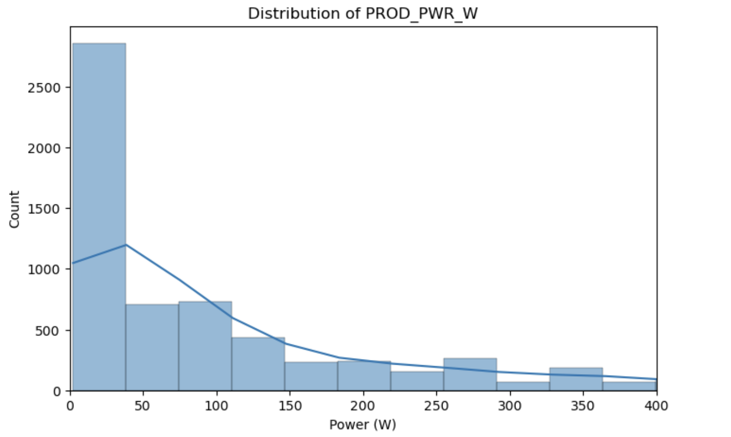
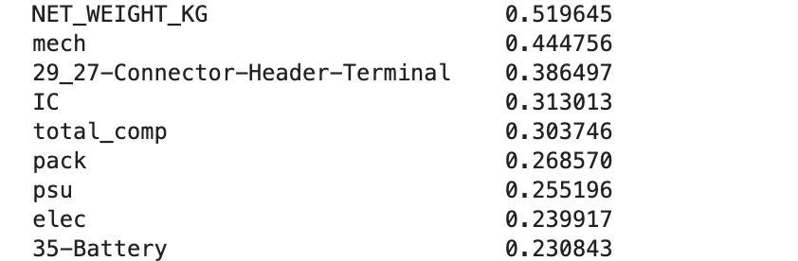
Product Power Prediction Model Development
Correlation Data for Model 3: Power Prediction
Figure: Correlation of numerical data against target variable (power)
Figure: Distribution of power across products
Majority of products are below 50 W.
There is a long tail and graph has been limited to 400 W and below.

Slide 29
Model 3: Prediction Results
Type | Test RMSE
Dummy Classifier | 241.43
Type | Test RMSE
Linear Regression | 210.46
KNN | 124.58
SVR | 144.26
Random Forest | 116.50
Gradient Boosting | 128.06
Hyperparameter | Value
N Estimators | 100
Max Depth | None
Min Sample Split | 2
The dummy classifier produced a test RMSE of 241.43.
Among the five models, Random Forest achieved the lowest RMSE of 116.5, using hyperparameters: n_estimators = 100, max_depth = None, and min_samples_split = 2.
RMSE was chosen as the scoring metric because:
It penalizes large prediction errors, helping models minimize outliers.
It provides a consistent basis for comparison across different models.

Slide 30
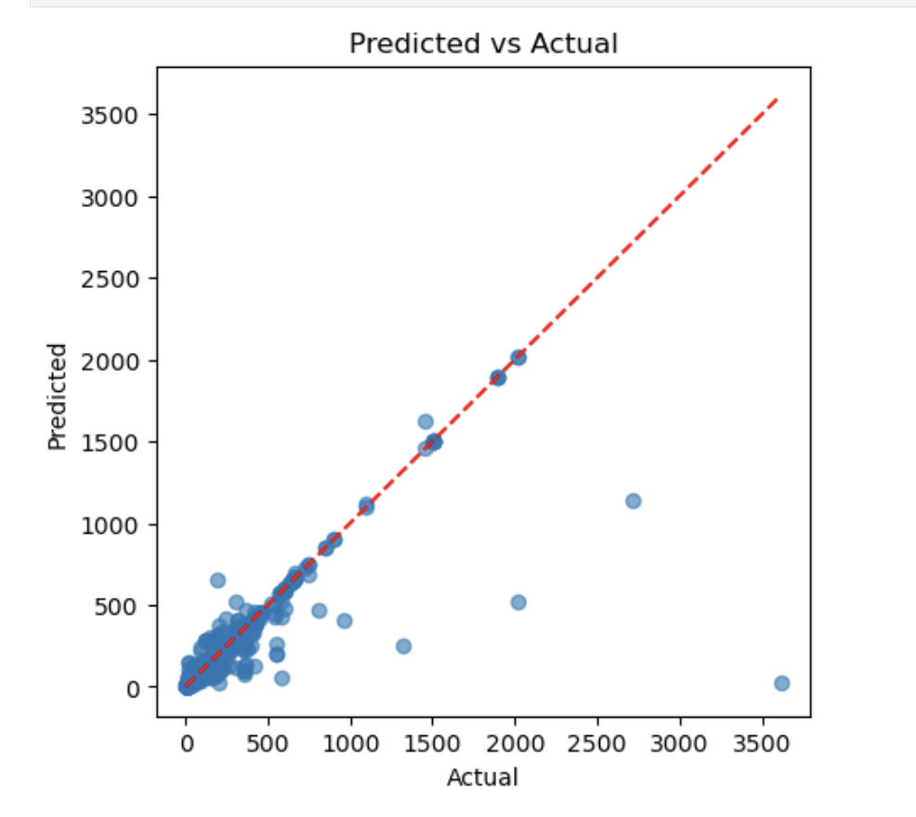
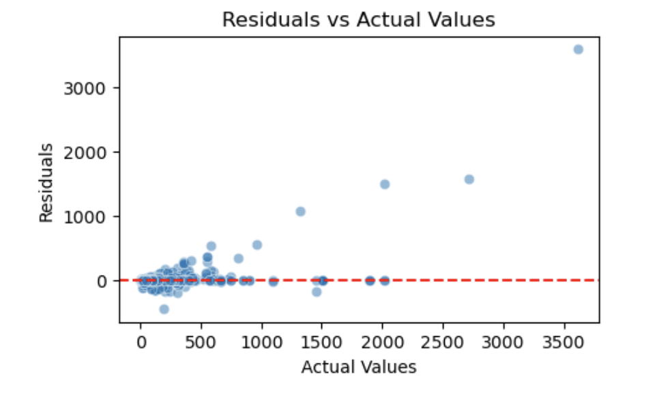
Model 3: Product Weight Prediction Results
A Predicted vs. Actual plot compares model predictions to true values, with points near the diagonal line y=x indicating low prediction error.
Points above or below the diagonal show over- or under-predictions and scattered or patterned deviations reveal model errors or bias.
A Residuals vs. Actuals plot shows the differences between predicted and actual values (residuals) on the y-axis against actual values on the x-axis.
Points scattered randomly around zero indicate a good fit, while patterns or trends suggest bias or model misspecification.

Slide 31
Model 3: Results Summary
Goal | With the completed dataset, train a new supervised learning model that predict power for products without power data.
Results | The dummy classifier produced a test RMSE of 241.43. Among the five models, Random Forest achieved the lowest RMSE of 116.50, using hyperparameters: n_estimators = 100, max_depth = None, and min_samples_split = 2. RMSE was chosen as the scoring metric because: It penalizes large prediction errors, helping models minimize outliers. It provides a consistent basis for comparison across different models.
Best Parameters | N Estimators = 100 Max Depth: None Min Sample Split = 2
Summary | The project evaluated five regression models to predict the target variable, with Random Forest performing best (RMSE = 116.50) compared to the baseline dummy model (RMSE = 241.43). RMSE was chosen as the metric because it penalizes large errors and enables fair comparison across models, allowing more accurate and reliable predictions of product power—a key attribute for estimating the greenhouse gas emissions associated with Cisco’s products.

Slide 32
Conclusion
Goal | The objective is to create a model that can estimate the typical power of our products.
Process | Product Classification: Develop supervised learning to predict product type based on Bill of Materials (BOM) information and other categorical data. Predict Product Weight: Develop a supervised learning model to predict product weight, leveraging the relationship between weight and BOM information. Predict Product Power: With the completed dataset to train a new supervised learning model that predict power for products without power data.
Results | Product Classification Gradient Boosting Predict Product Weight Random Forest Predict Power Power Random Forest
Summary | The electricity consumed by Cisco’s products represents its largest source of greenhouse gas emissions. By improving estimates of power for products lacking data, we can more accurately calculate the total annual emissions resulting from the sale and use of our products. This enhanced estimation will support better tracking and reduction of our overall environmental impact.

Slide 33
Next Steps
Integrate Models into Existing Systems: Automate the classification, weight, and power prediction processes directly within the associated tools. This ensures new products automatically receive estimated data, preventing future data gaps.
Expand Data Collection for Outliers: For the weight prediction model, investigate the nature of products exceeding 20 kg that were excluded. Develop targeted data collection strategies or specialized models for these larger products to achieve comprehensive weight prediction.
Continuous Model Monitoring and Retraining: Implement a system for ongoing monitoring of model performance (accuracy, RMSE) against new product data. Regularly retrain models with updated datasets to maintain accuracy and adapt to evolving product designs or component changes.
Explore Advanced Feature Engineering: Investigate additional features or more complex transformations from the extensive Bill of Materials (BOM) information that could further enhance the predictive power of all three models.
Quantify Prediction Uncertainty: For the weight and power prediction models, consider providing prediction intervals or confidence scores alongside point estimates. This would give users a better understanding of the reliability of each prediction.
Operationalize Emissions Reporting: Clearly define how the estimated power data will be used in the company's greenhouse gas emissions reporting and reduction strategies, linking the technical solution directly to business impact.

